Slide 1
3. GPS DATA MANAGEMENT FOR PATROL TASKING

Slide 2
THOUGHT EXERCISE
Imagine this:
You are a team leader and have been tasked to conduct a 5 day patrol deep inside the park where you have no comms with base.
On Day 2 your team unexpectedly runs into a live poacher camp. The poachers make a run for it and are not caught.
On Day 3 one of your team members develops a fever and needs to be evacuated. You change your route to speed up your return to the PUP, but do not encounter water sources all day and are forced to camp without water that night.
You return to base tired, dejected and your team member barely survives. You find out later that a previous team had been in the area a month before and had found a good trail and permanent spring.
Notes:
This scenario easily happens when briefings are incomplete and knowledge transfer between teams and teams and tasking officer is lacking.
Often we have a huge repository of useful information in our databases, but transmission of this back to the rangers is lacking.
One solution to this is to be diligent about equipping outgoing teams with the GPS information:
Location of key threats detected- camps, people, snares, to make teams alert when approaching the vicinity
Location of key nav features such as water sources, good campsites, trails etc, which facilitate patroller movement

Slide 3
DATA RECORDING PROTOCOLS
HUMAN ENCOUNTER
A SPECIFIC SET OF SYMBOLS ARE USED TO RECORD THREATS AND NAV WAYPOINTS TO ALLOW EASY LOCATION IN BASECAMP LATER. THIS CODE MUST BE AGREED ON AND STUCK TO.
DO NOT EVER RENAME WAYPOINTS (BASECAMP WILL AUTOMATICALLY RENAME ANYWAY)
USE AN AGREED ON CODE SET FOR NOTES
MAKE SURE THE TRACKS AUTOARCHIVE DAILY
GOOD CAMPSITE
GOOD WATER
GOOD CAMERA TRAP LOCATION
WILDLIFE SIGN
Notes:
The icons

Slide 4
1. FOLDER MANAGEMENT
In the GPS the tracks and
Notes:
Firstly all GPX data and camera image data must be stored in a folder on C Drive named with the patrol ID. This will later be entered into SMART
In Basecamp we have three key folders of lists:
Patrols
Key Obs
Key Nav features

Slide 5
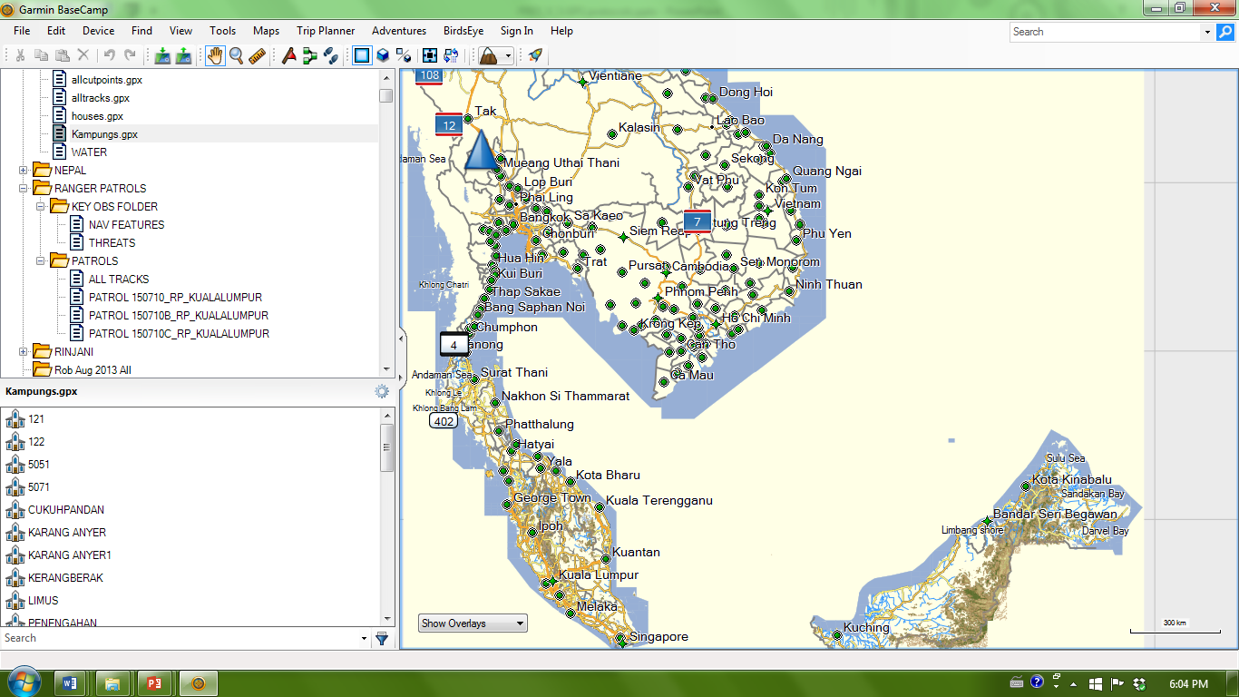
1. BASECAMP FOLDER MANAGEMENT
TWO LIST FOLDERS
Notes:
In Basecamp we have key folders of lists:
Key Obs Folder contains:
Nav Features list of important nav features: watering points, basecamps, etc
Threats list of most important threats- snares, camps, humans
All patrol data stored in Patrols folder with one list per patrol containing waypoints and tracks. Also an “All tracks’ list contains all tracks. This makes it easier to manage sending important tracklogs back to the GPS when tasking patrols.

Slide 6
INCOMING PATROL DATA

Slide 7
1. IMPORT PATROL DATA
CONNECT GPS AND CLICK ‘YEE’ TO ENTER MASS STORAGE MODE
GO TO THE FOLDER GARMIN>GPX AND COPY THE TRACK FILES AND THE WAYPOINTS FILES FOR THE SPECIFIC PATROL
PASTE THESE INTO THE PRE-NAMED PATROL RECORDS FOLDER IN C DRIVE
FROM HERE YOU CAN ENTER PATROL OBSERVATIONS INTO SMART. DO THIS AFTER FINISIHING THE DATA UPLOAD INTO BASECAMP

Slide 8
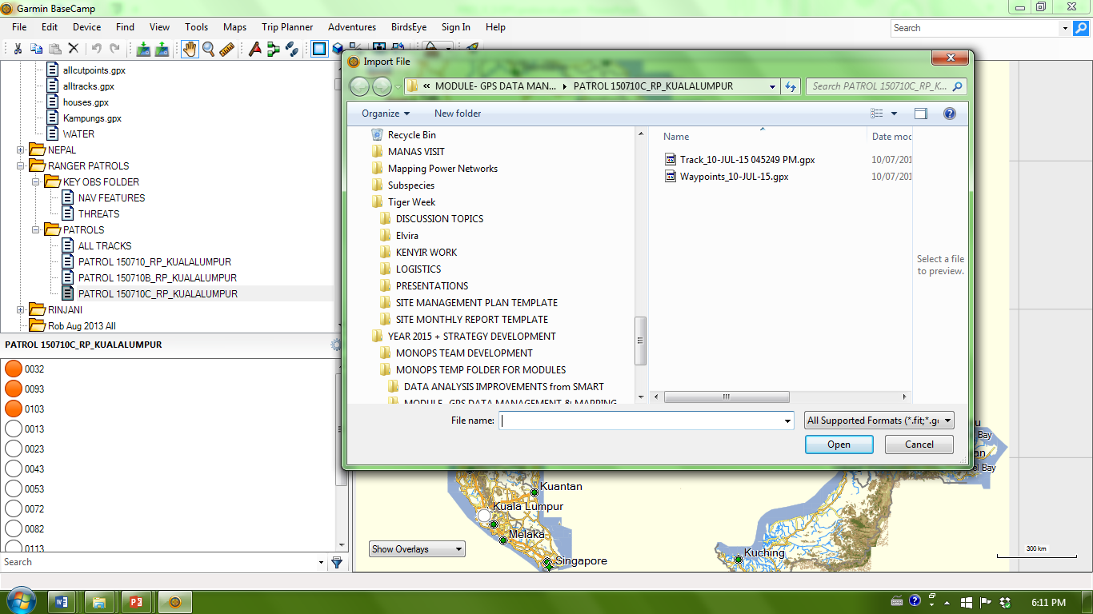
1. IMPORT PATROL DATA
2. FILE
LOCATE PATROL RECORDS ON C DRIVE AND HIGHLIGHT TRACKS AND WAYPOINTS
1. NEW LIST WITH PATROL ID

Slide 9
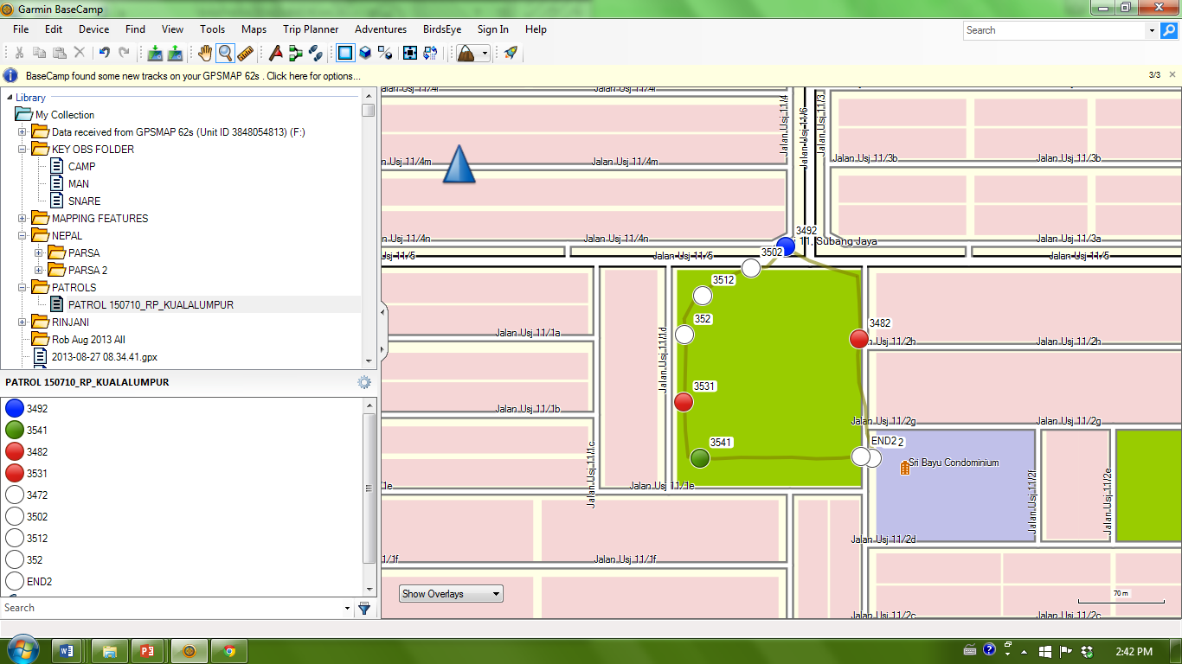
1. IMPORT PATROL DATA
PATROL TRACK AND ALL WAYPOINTS IMPORTED

Slide 10
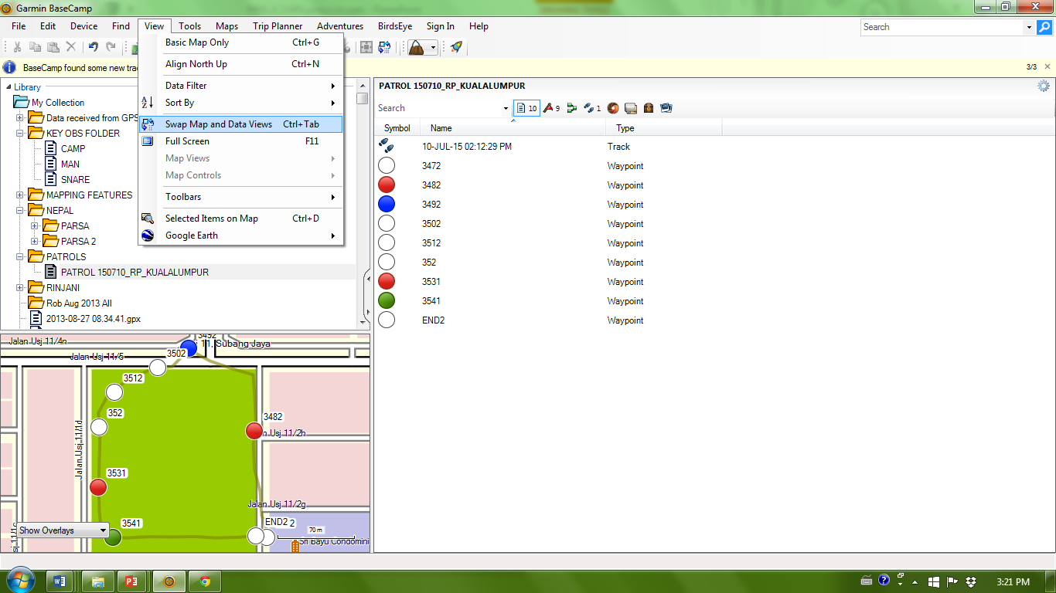
2. ADD KEY OBSERVATIONS TO LIST
SWITCH FROM MAP TO DATA VIEW

Slide 11
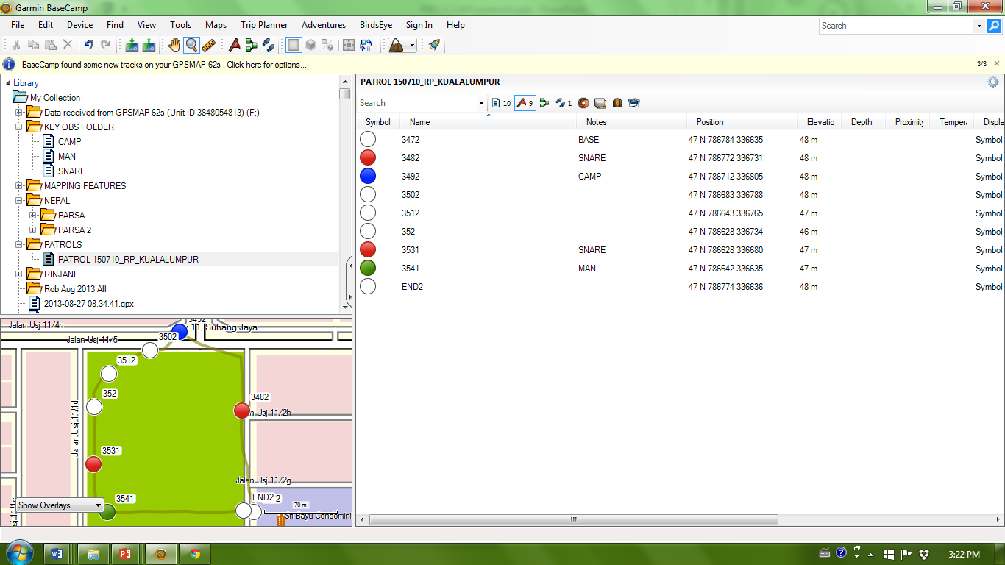
2. ADD KEY OBSERVATIONS TO LIST
CLICK HERE TO VIEW WAYPOINT DETAILS

Slide 12
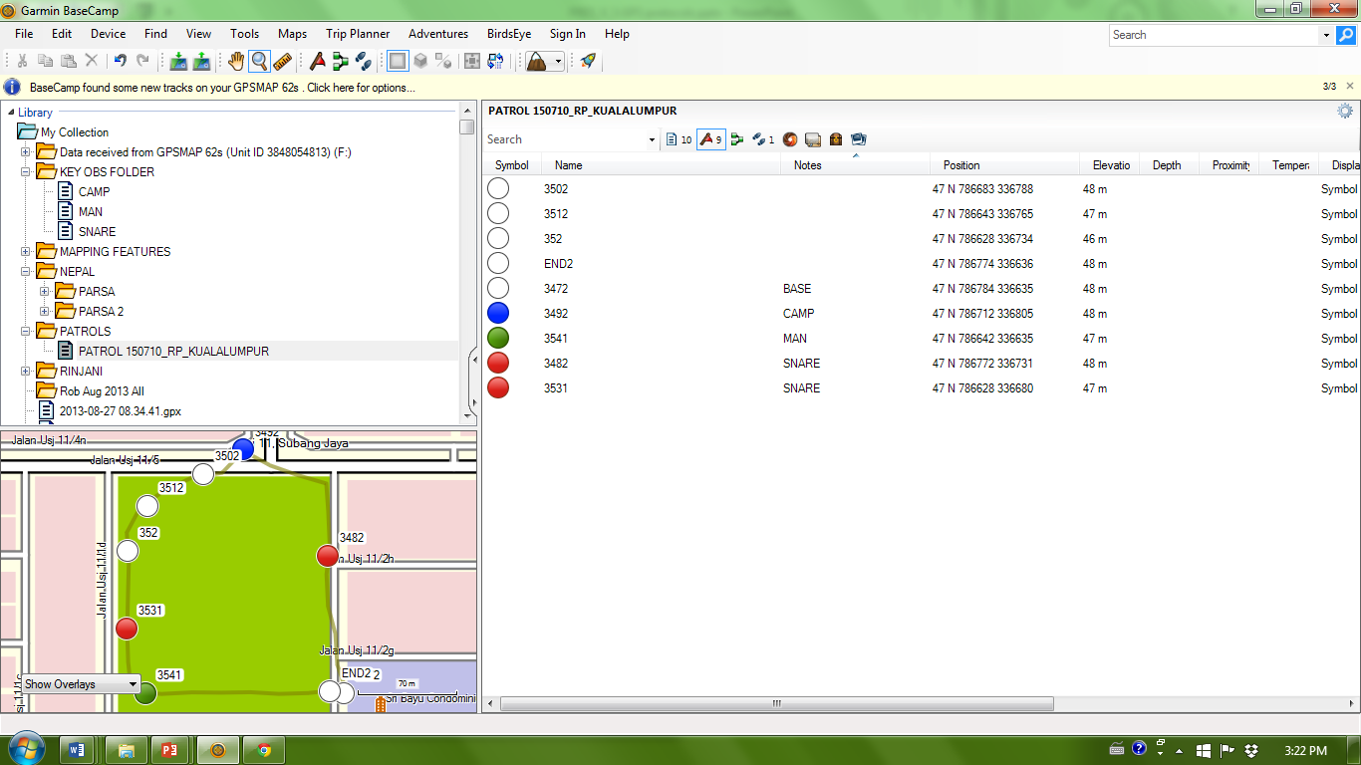
2. ADD KEY OBSERVATIONS TO LIST
CLCIK ON ‘NOTES’ TO SORT BY OBSERVATION TYPE. HERE WE HAVE TWO SNARES, A CAMP AND A HUMAN OBSERVATION

Slide 13
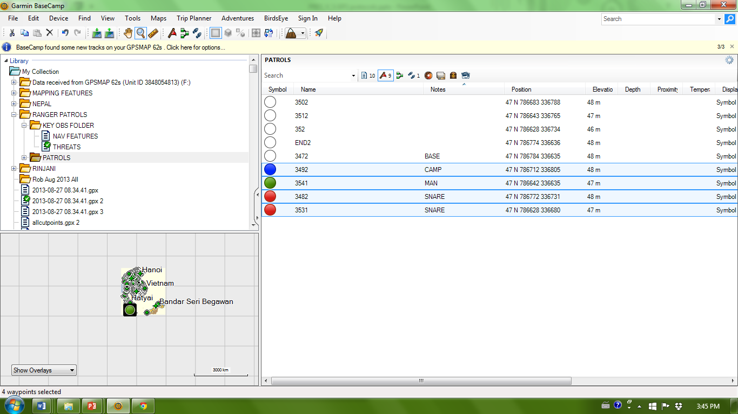
2. ADD KEY OBSERVATIONS TO LIST
2. DRAG THE SELCTED WAYPOINTS TO THE THREATS LIST
1. HIGHLIGHT THE THREAT OBSERVATIONS

Slide 14
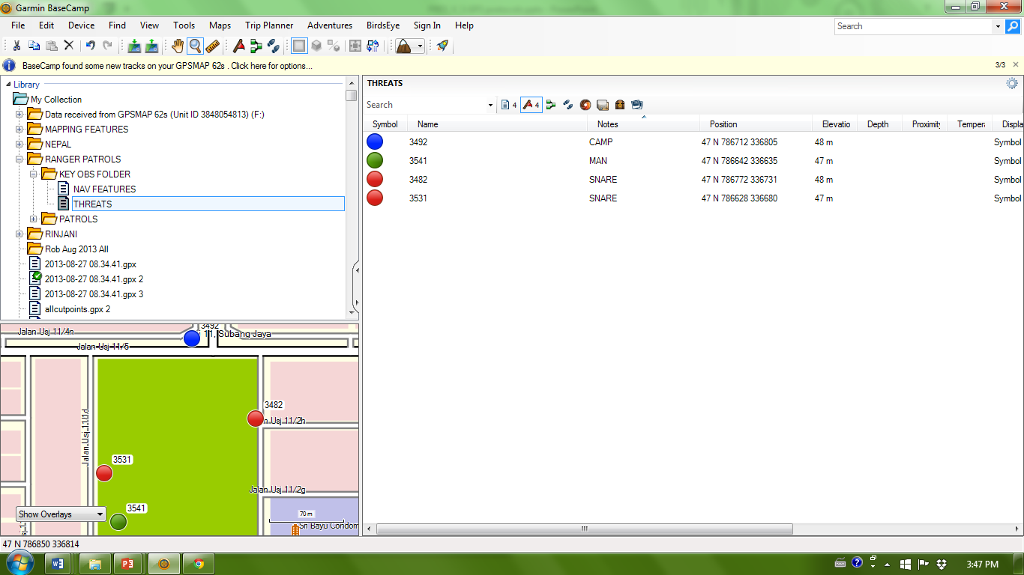
2. ADD KEY OBSERVATIONS TO LIST
YOU NOW HAVE A LIST FOLDER WITH YOUR MOST IMPORTANT OBSERVATIONS IN.

Slide 15
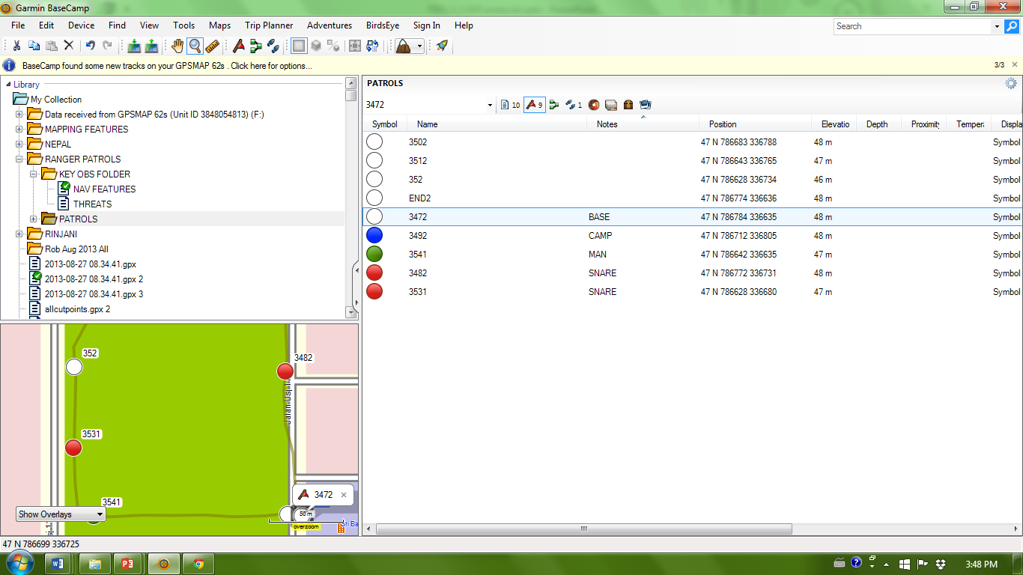
3. ADD NAV FEATURES TO LIST
DO THE SAME WITH THE NAV FEATURES: BASECAMPS, WATER SOURCES.

Slide 16
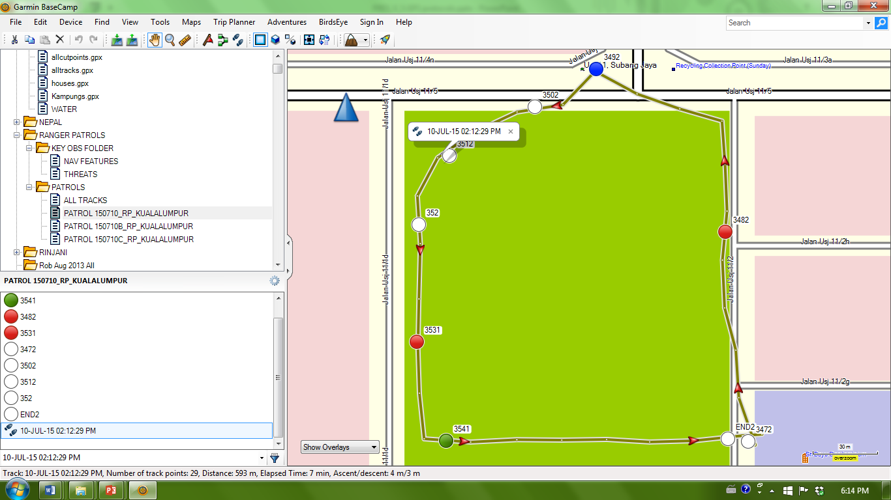
4. ADD TRACKS TO ‘ALLTRACKS’ LIST
MOVE THE TRACK FROM THE PATROL LIST TO THE ‘ALL TRACKS’ LIST

Slide 17
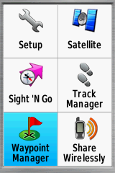
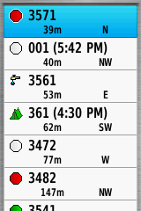
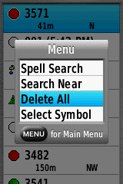
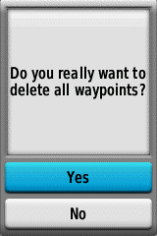
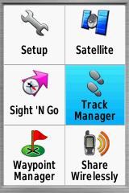
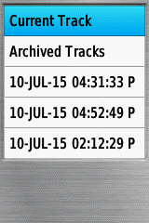
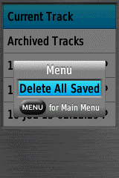
5. CLEAR THE GPS UNIT
Notes:
Clear both tracklog and waypoints

Slide 18
OUTGOING GPS UNITS
Notes:
WHEN PATROL TEAMS HAVE BEEN TASKED

Slide 19
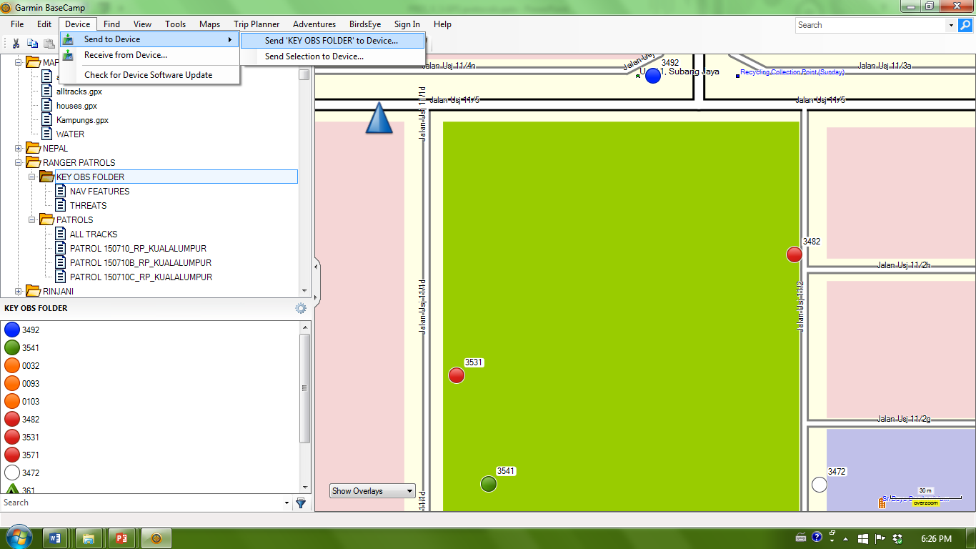
1. SEND KEY OBSERVATIONS TO UNIT
CLICK ‘DEVICE’
FIND GPS UNIT
Notes:
SEND ALL KEY OBSERVATIONS IN THE AREA COVERED BY THE PATROL TEAM TO THE GPS UNIT

Slide 20
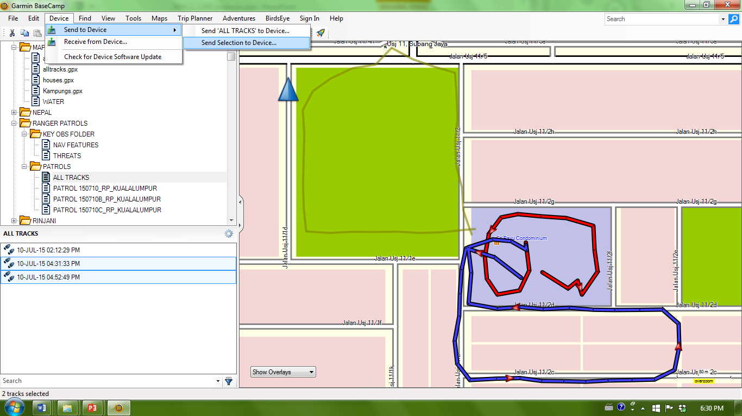
2. SEND USEFUL TRACKS TO UNIT
SELECT “SEND SELECTION TO DEVICE”
SELECT TOOL USED TO HIGHLIGHT TRACKS IN THE AREA TO BE PATROLLED
IMPORTANT TRACKS SELECTED

Slide 21
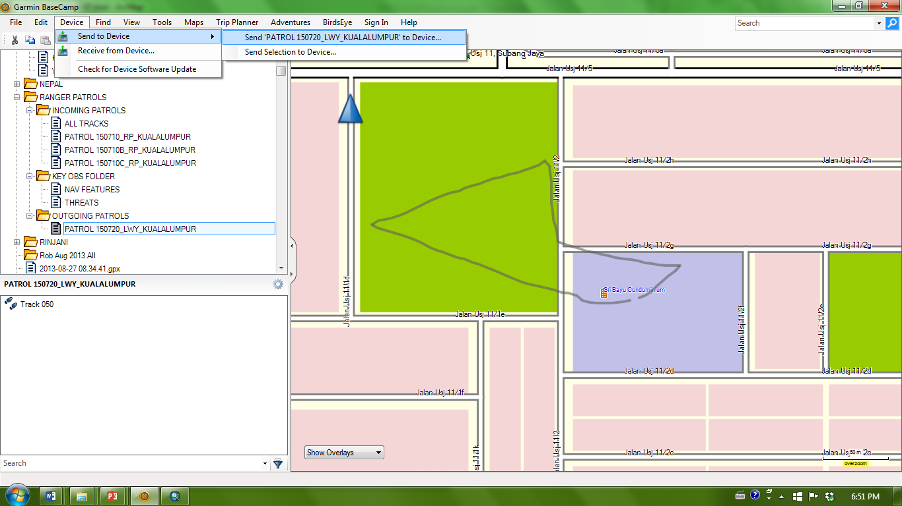
3. SEND PATROL ROUTES TO GPS
SEND TO DEVICE
SELECT PATROL LIST CONTAINING TRACKS FROM OUTGOING PATROLS FOLDER
Notes:
BE SURE THAT THE DESIGNATED PATROL ROUTES GO TO THE CORRECT NAMED GPS UNIT

